Slide 1
ITLG311 - Business Communication
Faculty of ICT, Mahidol University
Semester 1, 2026/2027
Week 7: Data Analysis and Business Briefing Preparation

Slide 2
Previously:
Consultation and the role of a consultant
Business meetings and meeting management
Agendas, meeting minutes, and action items
Professional teamwork
Project Updates
Collection of questionnaire responses

Slide 3
This Week:
Organize and analyze questionnaire responses
Identify patterns and important results
Select 3 key findings for management
Explain findings using evidence
Interpret what the findings suggest about the problem
Prepare and organize the Business Information Briefing

Slide 4
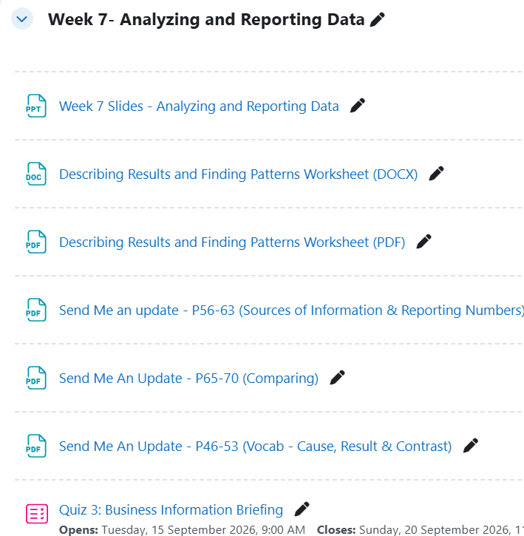
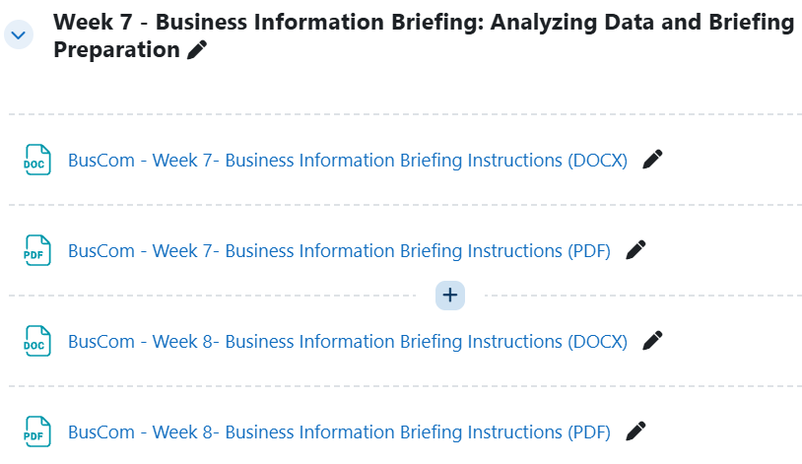
Resources

Slide 5
Project Status
Week 6: Management brief → team meeting → questionnaire → CEO update
Week 7: Analyze responses → identify findings → request briefing → prepare briefing
Week 8: Present findings to management through a Business Information briefing

Slide 6
From Responses to a Business Briefing
RAW RESPONSES
↓
ORGANIZE → group and count responses
↓
RESULTS → numbers, percentages, patterns
↓
PATTERNS AND KEY FINDINGS
↓
EVIDENCE
↓
INTERPRETATION
↓
BUSINESS INFORMATION BRIEFING

Slide 7
1. Organize the Responses
Group similar responses into categories
Count the number of responses in each category
Calculate percentages when useful
Use a table, chart, or figure when it makes the result clearer
Check that your totals and percentages are accurate

Slide 8
1.1 From Categories to Results
Example Problem: What problems do customers experience when ordering food through
delivery apps?
20 customers responded to the questionnaire seeking the reason for this issue and responses
were grouped and counted as followed:
Delivery-time problems: 8 customers (40%)
Order accuracy problems: 7 customers (35%)
Unavailable-item problems: 3 customers (15%)
Other problems: 2 customers (10%)
Do not just give the number. Help management see the results clearly:
Weak: 40% said this. 35% said this. 15% said this. 10% said this.
Better: Delivery-time problems were the most common issue, reported by 40% of respondents,
followed by order accuracy problems at 35%.

Slide 9
2 Presenting Results Clearly
When you collect questionnaire responses, you will usually have a number of people choosing
each answer. Percentages help you show these results.
When presenting questionnaire results, you do not always need to give the exact
percentage. Choose language that clearly shows the size of the result.
Language | Meaning | Example
nearly half | close to 50% | 47% → Nearly half of respondents…
about half | around 50% | 51% → About half of respondents…
about one-third | around 33% | 34% → About one-third of respondents…
a small minority | a small number of respondents | 10% → A small minority of respondents…
the majority | more than 50% | 65% → The majority of respondents…
less than half | below 50% | 40% → Less than half of respondents…

Slide 10
3. Identify Key Findings and Patterns
Once you have organized the results, look across the data to identify patterns and results that are important to your audience.
Focus on results that help you understand the problem.
Look for:
the most common response: What did the largest number of respondents report?
the least common response: What did the fewest respondents report?
clear similarities: Which results are similar in size or show a similar pattern?
clear differences: Which results are noticeably higher or lower than others?
surprising or notable results: is there anything unexpected or particularly interesting?
results especially relevant to the management brief: Which results directly help answer the problem management asked you to investigate?
Look for patterns that help explain the problem → these can become your key findings.

Slide 11
3.1 Findings
Result ≠ Finding
From Result to Finding
RESULT = what the data shows
10 out of 20 customers reported delivery delays.
FINDING = the important message from the result
Delivery delays were the most common problem reported by customers.
A finding tells management why the result matters.
STEP 1: Identify the data
What does the data show?
STEP 2: Find the Pattern
What do you notice when you compare the results?
STEP 3: Describe the pattern
What language can you use?
STEP 4: Turn the pattern into a finding
What is the important message?

Slide 12
4. Support Each Finding with Evidence
A finding should be supported by evidence from the questionnaire.
Useful evidence includes:
• numbers
• percentages
• relevant opinions or comments from respondents
• tables or charts
Choose evidence that clearly supports the finding.

Slide 13
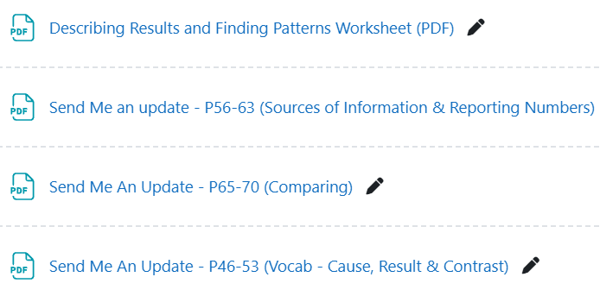



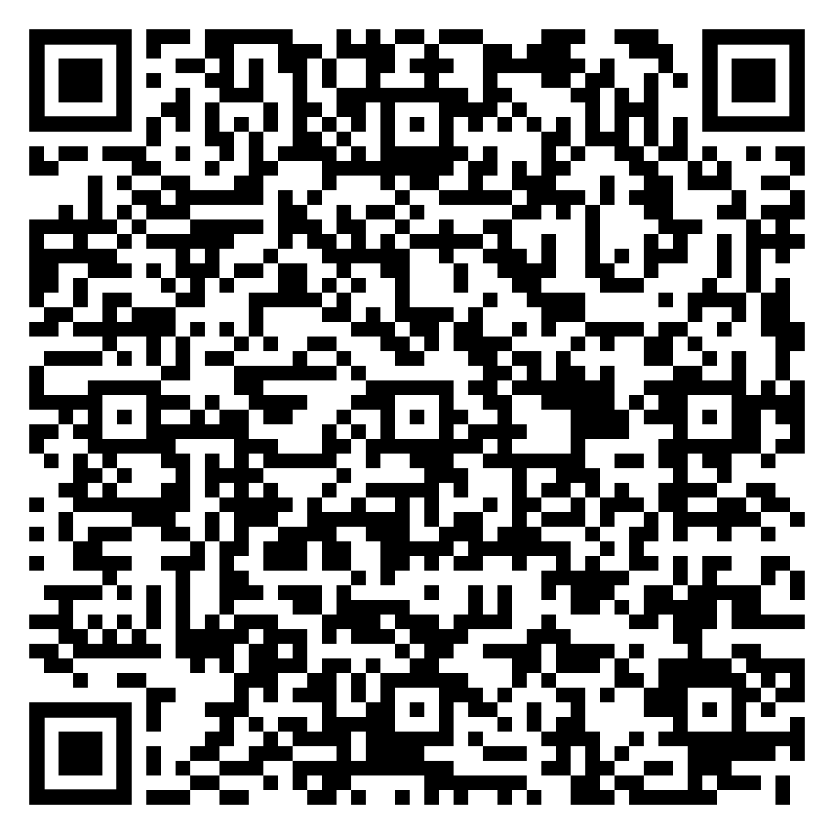
Useful Vocabulary When Reporting Results and Findings

Slide 14

Workshop:
Apply Data Analysis To Your Project
You have collected your questionnaire responses for your Business Information Briefing.
In your group, perform the following tasks with your data:
Group similar responses.
Count how many respondents gave each type of response.
Calculate percentages.
Look for important patterns.
Identify possible findings.
Choose your 3 strongest findings.
Find supporting evidence for each finding

Slide 15
Choose Your 3 Main Findings For Briefing
For your briefing, you should have 3 strong findings that are:
Ask these questions for each possible finding:
directly relevant to the management problem
important for management to know
clearly supported by your evidence
different enough to avoid repetition
Is it directly related to the problem?
Is it important for management?
Do we have clear evidence?
Does it tell management something useful?
Is it different from our other findings?

Slide 16
BREAK TIME

Slide 17
5. Interpretation
Interpretation goes beyond repeating the result.
Ask yourself:
• What does the finding suggest about the problem?
• Why is this important for management to understand?
Result: 70% reported that their food order arrived late.
Finding: Delivery delays were a major problem.
Interpretation: This suggests that delivery reliability is an important issue for customers.
Possible effect: This may affect customers' confidence in the service.

Slide 18
Workshop:
Apply Interpretation To Your Project
Use your 3 findings and evidence.
For each finding, discuss and write down the following:
What does this finding suggest about the problem?
What possible effect or impact could this have on the people, service, or organization involved?
Why might this matter to management?
Explain why the information matters. Do not give any solutions.

Slide 19
What You Have Done So Far:
Organized and analyzed your questionnaire responses
identified important patterns
selected 3 findings
identified evidence to support each finding
Interpreted each finding
Now turn this information into your Business Information Briefing.

Slide 20

Business Information Briefing Structure
1. Introduction
2. The Problem
3. Investigation
4. Findings
5. Interpretation
6. Conclusion
No solutions or recommendations.

Slide 21
Presenting Each Finding
1. FINDING
What is the important message?
2. EVIDENCE
What data supports it?
3. INTERPRETATION
What does the evidence suggest?
4. IMPACT
Why does this matter to management?
Keep each finding focused on the problem.

Slide 22
Slide Format
One main message per slide
Use short phrases, not a script
Show important numbers clearly
Use a simple chart or table when it helps
Make the finding easy to see
Do not put every questionnaire response on the slide
The speaker explains; the slide supports

Slide 23
Check Data Before Briefing
Check that:
• totals match the number of respondents
• percentages are calculated correctly
• categories do not overlap
• charts and labels match the data presented
• quotations are accurate
• every finding is supported by evidence
• your interpretation does not go beyond the evidence

Slide 24
5- Minute Briefing: Plan Your Time
Your Week 8 Briefing is 5 minutes long, followed by 2 questions from management.
Introduction + Problem: about 45–60 seconds
Investigation: about 30–45 seconds
3 Findings + Evidence + Interpretation: about 3 minutes
Conclusion: about 30 seconds
Rehearse with a timer.
Everyone should speak.

Slide 25
Answering Management Questions
Listen to the whole question.
Answer the question directly using the RARE question- answering technique.
Use your investigation as evidence.
If you do not know, say so professionally.
Do not invent information.
Remember: management is asking about your investigation and findings.
What does RARE stand for?
Notes:
RARE Answer Structure:
Restate the question
Answer it clearly
Give a Reason
Give an Example

Slide 26
Business Information Briefing Deliverables for Next Week
Submit the following 2 days before your next class:
Meeting Request
Business Briefing Planning Template
Final Update to the CEO
Presentation Slides
Submit ONE set of documents per group 2 days before the next class.

Slide 27
Lesson Recap: Key Takeaways
Good business briefings do not simply report data.
They turn information into clear findings, explain what those findings suggest, and help management understand the problem.
DATA → FINDINGS → INTERPRETATION → CLEAR BUSINESS MESSAGE

Slide 28
NOTICE: Quiz 3
MyCourses Quiz 3: Business Information Briefing
Consultancy Theory
Meeting Management Theory
Questionnaire Theory
Data Analysis Theory
Fundamental Business Vocabulary/Phrasing
Quiz Conditions:
Quiz 3 will close at 23:59, Sunday 20 September 2026
Only one attempt allowed
One hour (60 minutes) time limit
Be sure to review week 6 and 7 notes and resources before your attempt
GOOD LUCK!

Slide 29
Congratulations on surviving another class
THANK YOU for your participation today
Have a great week everyone!
See you next week
Until then, Take Care & Stay Safe
Finally….

